Slide 1
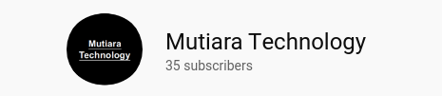
HUE, SATURATION, VALUE (HSV)
Arif Mudi Priyatno

Slide 2
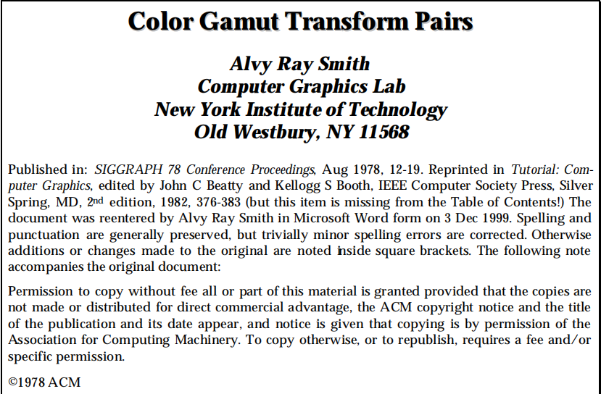
Referensi

Slide 3
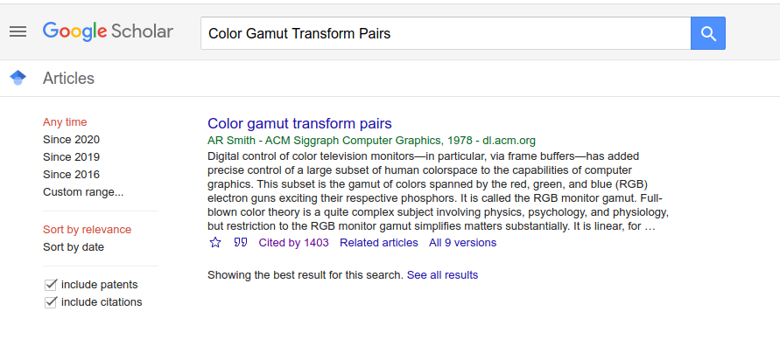

Slide 4
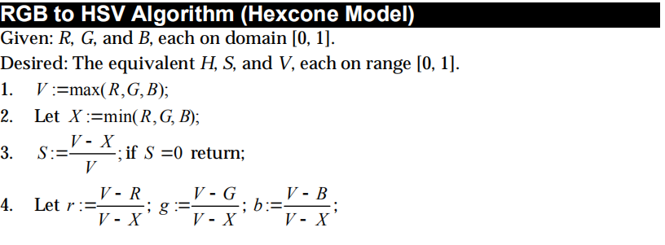
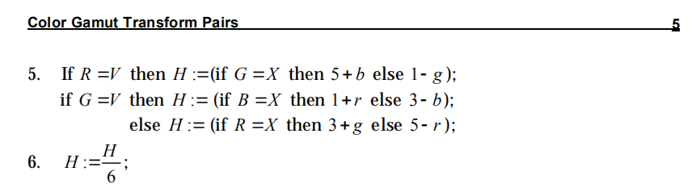

Slide 5



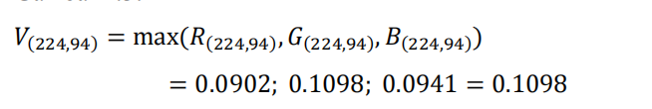
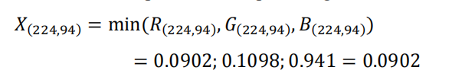
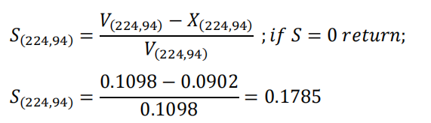

Slide 6
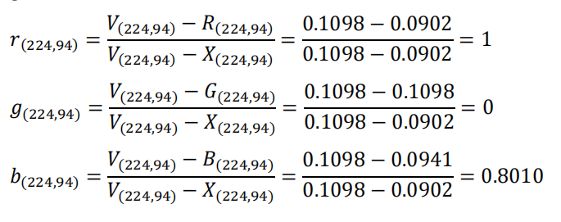



Slide 7
Code di Matlab

Slide 8
Mutiara Technology
instagram.com/cakra.karta/
linkedin.com/in/arifmudipriyatno/
t.me/arif_mudi

